Slide 1
Management Information Systems
Group Project
Group Member：
GOH LI HAN 2018059078
LAI MINGYI 2018054619
YE HAIPING 2018054615
07-12-2021

Slide 2

Build an Application:
Warehouse can manage their stocks
Command between warehouses(changing invoices location)
Able to create new invoices (making sales)
Able to manage delivery process (changing the delivery status)

Slide 3
Requirement Part 2
Show the Best active agents and their sales result
Show the Best active workers and their sales result
Who is the Top new phone buyer
Who is the Top active driver

Slide 4
Project Plan
Languages we use：Python, SQLite
Tools we use:
1. SQLite3 from python (database)
2. Tkinter from python (GUI)
3. DBeaver (to test our quary)
4. Visual Studio Code, PyCharm
5. Github (for version control and collaboration)

Slide 5
File Descriptions
Main File
1. Main.py All the functions are here, Run this file in ternminal.
2. CreatingDatabase.py Create database with preset tables.
3. AddingData.py Input the preset data to the database.
4. system.db The database file created from CreatingDatabase.py
Not Crucial File
5. DbFunction.py We use to test our Python+SQLite functions

Slide 6
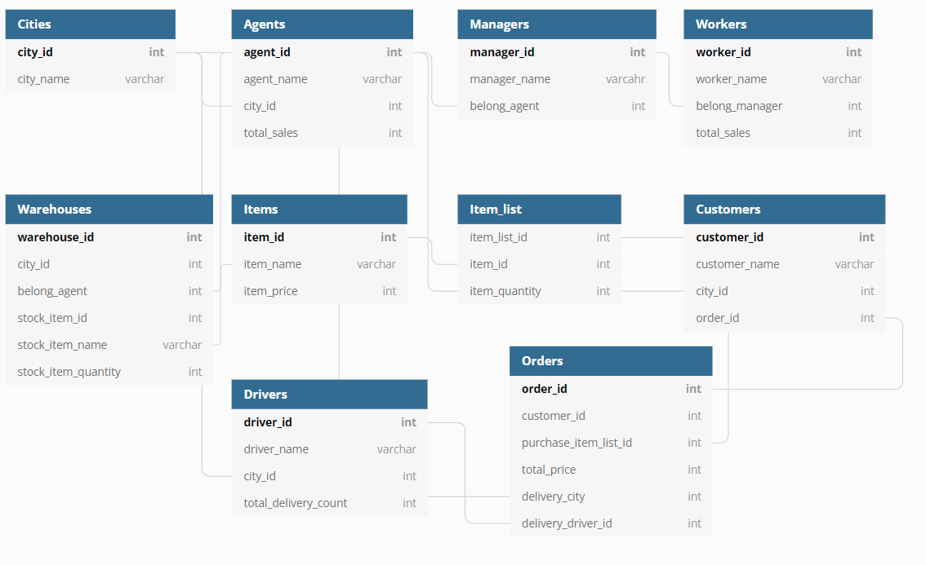
Draft

Slide 7
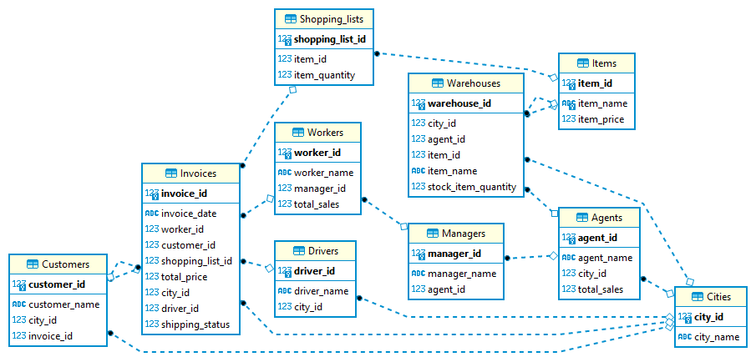
Result
Database ER Diagram

Slide 8
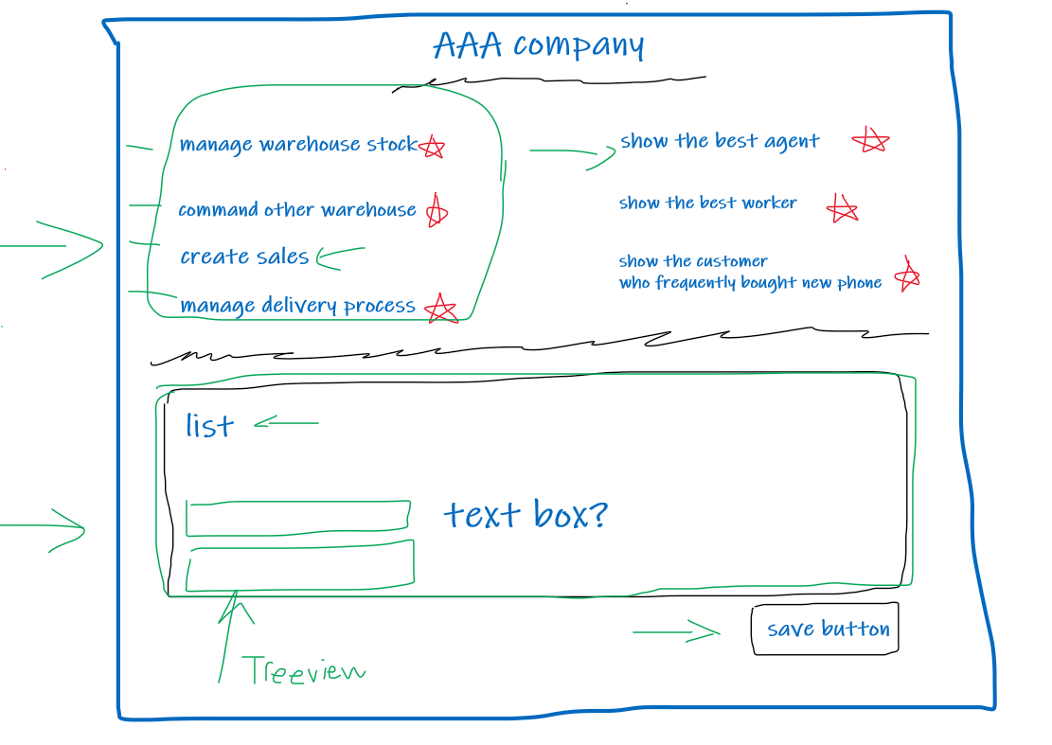
Draft

Slide 9
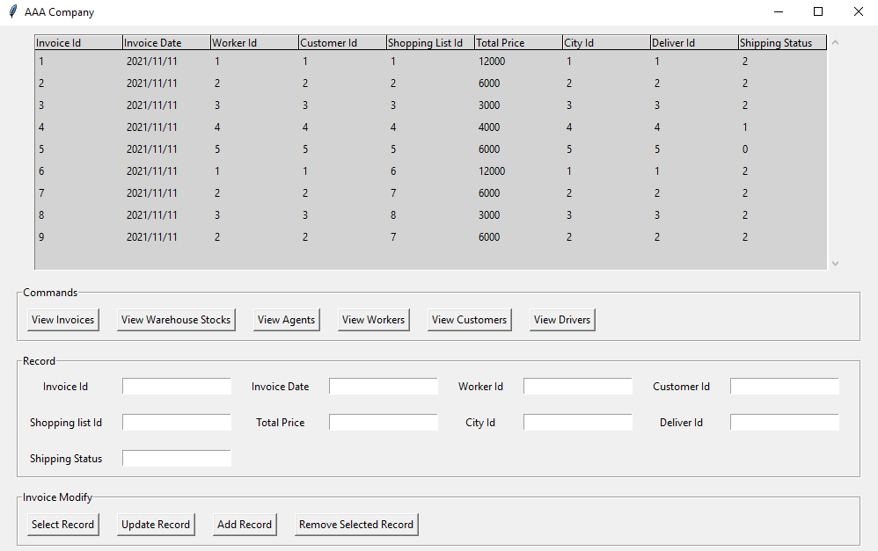
Result
The Final Application

Slide 10

Application Showcase

Slide 11
THANK YOU

